Slide 1
POOJA R.
821721104038
BE COMPUTER SCIENCE AND ENGINEERING
SIR ISSAC NEWTON COLLEGE OF ENGINEERING AND TECHNOLOGY

Slide 2

HEART FAILURE PREDICTION(ANN)

Slide 3


AGENDA
Collect medical data, select key predictors, preprocess data, choose suitable algorithms, train models, evaluate performance, validate on new data, deploy into practice, monitor ongoing performance, and ensure ethical considerations regarding fairness and privacy are met.
Data Collection : Gather medical data.
Feature Selection : Choose important predictors.
Preprocessing: Clean and transform data.
Model Selection : Pick suitable algorithms.
Training : Train models on the data.
Evaluation : Assess model performance.
Validation : Validate on new data.
Deployment : Integrate into practice.
Monitoring : Continuously assess performance.
Ethical Considerations : Ensure fairness and privacy.
3/21/2024 Annual Review

Slide 4

PROBLEM STATEMENT
Collect medical data, select key predictors, preprocess data, choose suitable algorithms, train models, evaluate performance, validate on new data, deploy into practice, monitor ongoing performance, and ensure ethical considerations regarding fairness and privacy are met.
Preparation for heart failure prediction entails comprehensive data collection, feature selection, understanding machine learning algorithms, data preprocessing, securing adequate computational resources, developing expertise in data analysis, ensuring ethical compliance, planning validation strategies, fostering interdisciplinary collaboration, effective communication, and staying updated with advancements. Continuous learning ensures the integration of emerging techniques to enhance predictive modeling approaches for heart failure prediction.

Slide 5

PROJECT OVERVIEW
Title: Heart Failure Prediction System
Objective: Develop a machine learning-based system to predict heart failure risk in patients using clinical data. Components include data collection, preprocessing, model selection, training, deployment, monitoring, and ethical considerations. Aim: Improve early detection for better patient outcomes.
To create a machine learning model for early heart failure detection using patient data. Components: Data collection, preprocessing, model selection, training, validation, deployment, monitoring, and ethical considerations. Outcome: Enhanced patient care through timely intervention and improved resource allocation in healthcare.

Slide 6
WHO ARE THE END USERS?
The end users of the heart failure prediction system include healthcare professionals such as physicians, cardiologists, nurses, and other medical staff involved in patient care. Additionally, patients themselves may indirectly
benefit from the system’s predictions by receiving timely interventions and improved healthcare outcomes.
The end users of the heart failure prediction system are healthcare providers, including physicians, cardiologists, and nurses, who utilize the system to assess patients’ risk of heart failure. Patients also indirectly benefit from the system by receiving timely interventions and personalized healthcare based on predictive insights derived from their medical data.
Healthcare providers, including physicians, nurses, and cardiologists, are the primary end users, utilizing the system to assess and manage patients’ risk of heart failure for improved clinical decision-making and patient care.

Slide 7

YOUR SOLUTION AND ITS VALUE PROPOSITION
Solution:Our heart failure prediction system leverages machine learning algorithms to analyze patient data and provide early detection of heart failure risk.
Value Proposition:By accurately predicting heart failure risk, our system enables healthcare providers to intervene proactively, leading to improved patient outcomes, reduced hospitalizations, and optimized resource allocation in healthcare settings.
Our heart failure prediction system delivers timely risk assessments, enabling proactive interventions, improving patient outcomes, and optimizing healthcare resource allocation, ultimately enhancing overall healthcare efficacy and efficiency.

Slide 8

THE WOW IN YOUR SOLUTION
The wow factor in our solution lies in its ability to harness cutting-edge machine learning algorithms to accurately predict heart failure risk early on, empowering healthcare providers to implement proactive interventions that significantly improve patient outcomes and optimize healthcare resource allocation, leading to transformative advancements in patient care.
Our solution’s wow factor stems from its transformative impact on healthcare: by seamlessly integrating advanced machine learning techniques, it enables healthcare providers to foresee heart failure risks with unprecedented accuracy. This empowers proactive interventions, revolutionizing patient care, and resource optimization, thus setting a new standard for healthcare excellence.
3/21/2024 Annual Review

Slide 9
MODELLING
Modeling heart failure prediction involves data preparation, feature selection/engineering, selecting algorithms like logistic regression or random forest, training models, evaluating performance with metrics like accuracy and AUC-ROC, fine-tuning for optimization, validating on test data, ensuring interpretability, and deploying the best-performing model into clinical practice.
In heart failure prediction modeling, thorough data preparation ensures accuracy. Feature engineering enhances predictive power. Models, including logistic regression or random forest, are trained and evaluated meticulously. Fine-tuning optimizes performance, validated on test data. The selected model, with ensured interpretability, is deployed effectively into clinical practice for proactive heart failure management.
9

Slide 10
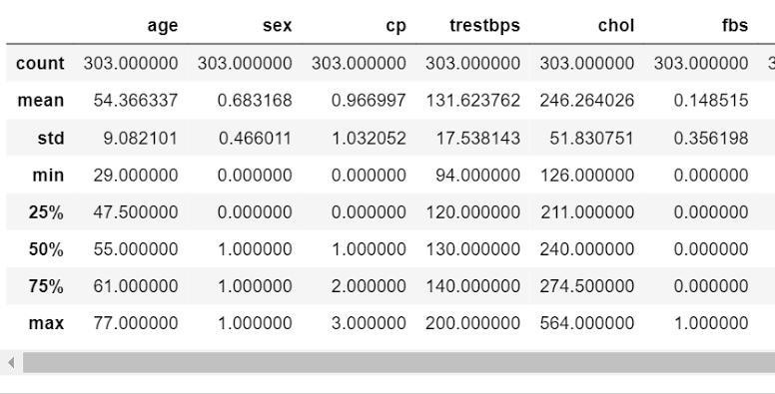
RESULTS
HEART DISEASE PREDICTION USING ANN
n
10

